Slide 1
Python Machine Learning In Biology:
Bias-Variance Tradeoff
Nichole Bennett

Slide 2
Errors
We really care about two types of prediction errors:
Errors due to “bias”
Errors due to “variance”
There’s a tradeoff between a model’s ability to minimize both of these.
Diagnosing bias and variance can help us figure out if our models are overfitting or underfitting.

Slide 3


Bias and Variance
Imagine we are repeating the model building process more than once. Each time we gather new data and run a new analysis, creating a new model.
Error due to Bias: difference between the expected (or average) prediction of our model and the correct value which we are trying to predict.
Error due to Variance: the variability of a model prediction for a given data point; the spread/uncertainty of these estimates

Slide 4
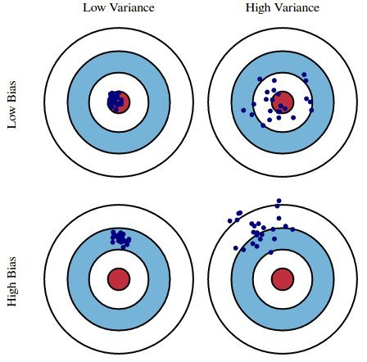

Slide 5
Bias and Variance
Model performs well on training data but does not generalize well to unseen data (test data)
If a models suffers from overfitting, we say it has high variance
May be too many hyperparameters (too complex for underyling data)
If a model suffers from underfitting, we say it has high bias
Model not complex enough to capture pattern in training data
Low performance on unseen data (and seen data)

Slide 6
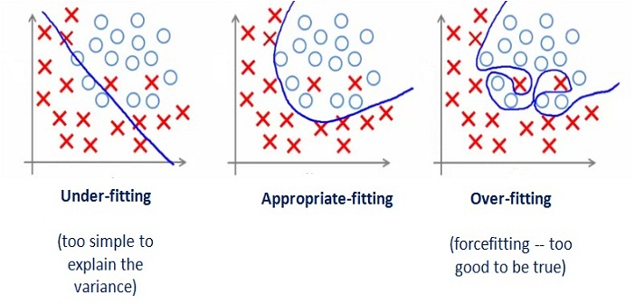

Slide 7
Voting Example
Let’s say we do a phone poll and try to figure out who is going to win the next election. We pick 50 numbers randomly out of the phone book and record who they say they will vote for.
Our answers are off. We obviously have lots of sources of error, but let’s separate the sources into errors of bias and errors of variance.

Slide 8
Voting Example
What are some of the sources of error in our voting example?
only sampled people from the phone book
did not follow up with non-respondents
have a very small sample size
Which of these are bias errors and which are variance errors?

Slide 9
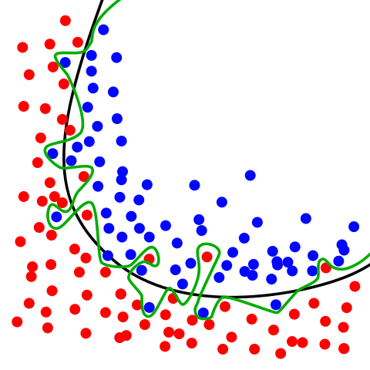

Slide 10
Managing Bias and Variance
Fight Your Instincts: that gut feeling that says to minimize bias at the expense of variance is wrong
Doing well on the training set is easy (just memorize the data)--> it’s generalization that counts
Bagging (Bootstrap Aggregating) and Resampling: use ensemble methods (e.g. Random Forests)

Slide 11
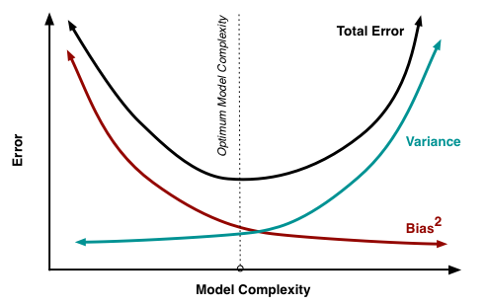
Bias-Variance Tradeoff

Slide 12
Regularization

Slide 13
Underfitting vs. Overfitting

Slide 14
Dealing with Overfitting
Cross-validation sampling
Choose a simpler model with fewer parameters
Reduce the dimensionality of the data
Pruning
Regularization
Collect more training data

Slide 15
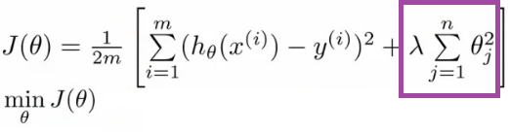
Regularization
Handles collinearity (high correlation between features), filters out noise from data, and helps prevents overfitting.
Regularization adds a penalty as model complexity increases.
Regularization will add the penalty for higher terms. This will decrease the importance given to higher terms and will bring the model towards less complex equation.

Slide 16
Choosing a Regulariation Parameter
more traditional approach:
choose λ such that some information criterion, e.g., AIC or BIC, is the smallest. (Emphasizes model’s fit to data)
more machine learning-like approach:
perform cross-validation and select the value of λ that minimizes the cross-validated error. (Emphasizes predictive performance)

Slide 17


L1 vs L2 Regularization
Key difference is the penalty term
L1 = Lasso
Adds “absolute value of magnitude” of coefficient as penalty term to the loss function.
If λ=0, back to original model.
If λ big, will make coefficients zero and will underfit.
Shrinks least important coefficient.
Selects most important features.
L2 = Ridge
Adds a “squared magnitude” of coefficient as penalty term to the loss function.
If λ=0, back to original model.
If λ big, adds too much weight and underfits.
Penalizes complexity.
Notes:
Shown here is an OLS regression cost function
Choose L1 for high-dimensional datasets with many irrelevant features

Slide 18
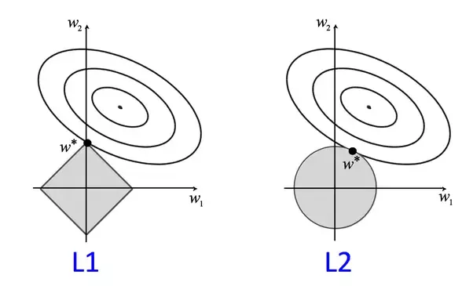
Notes:
Counter map of a cost function (SSE for simplicity) for two weights.
We want to find the combination of weights that minimizes the cost. (middle dot of each contour map)
Regularization adds a penalty term to the cost function to encourage smaller weights (penalize larger ones)
Increasing regularization strength with lambda shrinks the weights to zero and decreases the model’s dependence on training data
L2 is shaded quadratic regularization ball λ||w_2||^2
Can’t exceed our regularization budget (combo of weight coefficients can’t fall outside of the ball)
But we still want to minimize the cost function
Higher λ leads to narrower ball (infinity would have overlap at (0,0))
Want to minimize sum of unpenalized cost function plus the penalty term
Adds bias and favors a simpler model
L1 penalty is the sum of the absolute weight coefficients, so it has a diamond shape
Contour of the cost function touches the L1 diamond at w_1=0
Since the contours are sharp, it is more likely that the optimum (intersection) is located on an axis--encourages sparsity

Slide 19
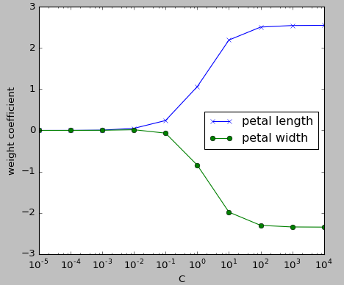
L2 Regularization in Python
Increasing λ, increases regularization strength
The parameter c that is implemented in the LogisticRegression class in scikit-learn is the inverse of the regularization parameter λ.
Decreasing c increases regularization strength.

Slide 20
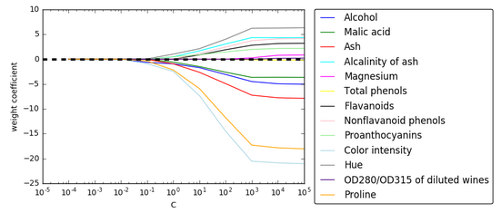
L1 Regularization in Python
Set the penalty parameter to ‘l1’ to yield the sparse solution.
Increasing λ, increases regularization strength. The parameter c that is implemented in the LogisticRegression class in scikit-learn is the inverse of the regularization parameter λ. Decreasing c increases regularization strength.

Slide 21
When to use regularization
Other methods, like cross-validation or stepwise models handle overfitting and perform feature selection work well with a small set of features but these techniques are a great alternative when we are dealing with a large set of features.
Can’t use regularization on KNN and Decision Trees. (Have to rely on feature engineering and dimensionality reduction)
Best for when you have small amounts of training data compared to your amount of features. Becomes less important as amount of training data you have increases.

Slide 22
When to use Lasso (L1) vs. Ridge (L2)
Often neither one is overall better.
Lasso can set some coefficients to zero, thus performing variable selection, while ridge regression cannot.
Both methods allow to use correlated predictors, but they solve multicollinearity issue differently:
In ridge regression, the coefficients of correlated predictors are similar;
In lasso, one of the correlated predictors has a larger coefficient, while the rest are (nearly) zeroed.

Slide 23
When to use Lasso (L1) vs. Ridge (L2)
Lasso tends to do well if there are a small number of significant parameters and the others are close to zero (when only a few predictors actually influence the response).
Ridge works well if there are many large parameters of about the same value (when most predictors impact the response).
But, practically speaking, we don’t know the true parameter values, so this is pretty theoretical
Run cross-validation to select the more suited model for a specific case.
Or... combine the two! Elastic Net!

Slide 24

Elastic Net
First emerged as a result of critique on Lasso, whose variable selection can be too dependent on data and thus unstable.
The solution is to combine the penalties of ridge regression and lasso to get the best of both worlds. Elastic Net aims at minimizing the following loss function:
where α is the mixing parameter between Ridge (α = 0) and Lasso (α = 1).
Now, there are two parameters to tune: λ and α.

